Slide 1


Surface Stress and Phase Separation in Soft Adhesion
Jeremy Thaller and Josh Kang
Prof. Katharine Jensen

Slide 2
Question One
1
How does surface stress depend on strain in soft materials?

Slide 3
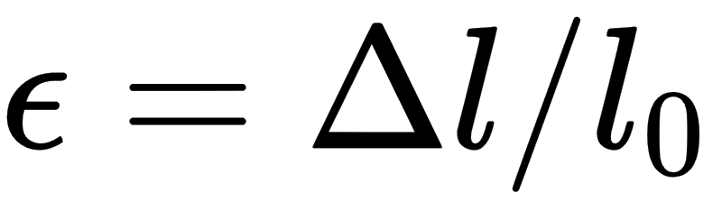
Quick Definitions
Surface Stress: The amount of work per unit area needed to stretch a material (elastically).
Strain:
How does surface stress depend on strain in soft materials?

Slide 4
What is Soft Matter?
Gels
Mostly liquid, interspersed in solid crosslinkers
High elasticity
Metals
Solid
Stiff (resists stretch)
Brittle
Assumed surface stress depends on strain

Slide 5
A Quick History
Gels are mostly liquid
Surface stress of liquid is INDEPENDENT of strain
When soft enough (in elastocapillary regime), surface tension dominates
2017, “Direct measurement of strain-dependent solid surface stress” (Qin Xu, Katharine E. Jensen, et al), Nature Communications

Slide 6
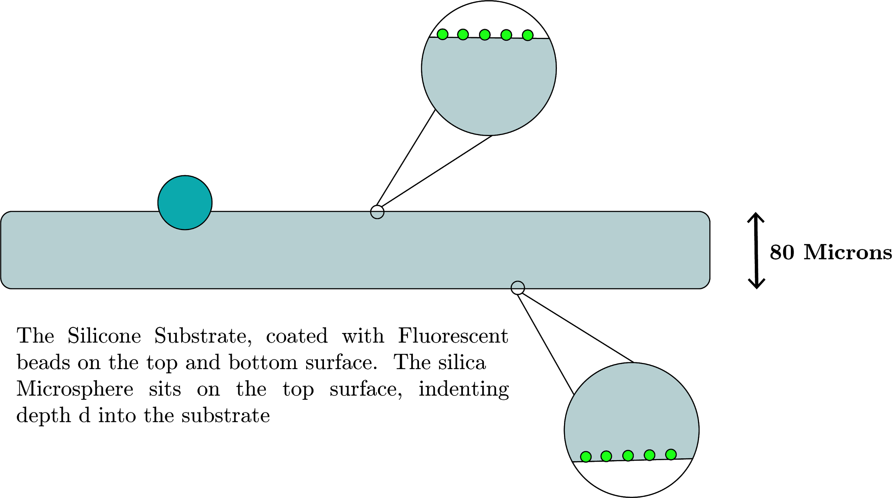
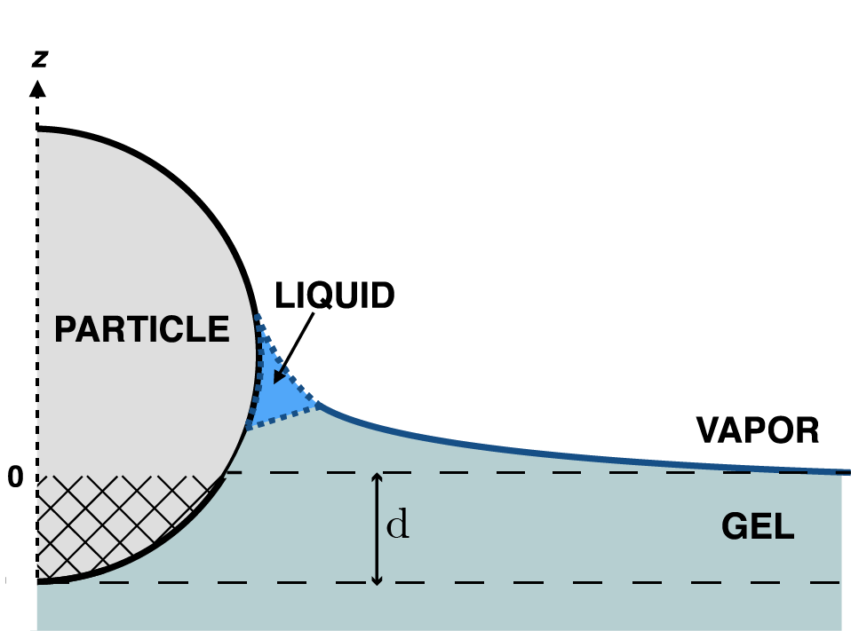
The Experiment
Silica Microspheres diameter ~ 30 microns
Fluorescent Beads diameter ~ 40nm
Bottom graphic adapted from Jensen et al. (2015) Wetting and phase separation in soft adhesion. PNAS 112 (47) 14490-14494

Slide 8
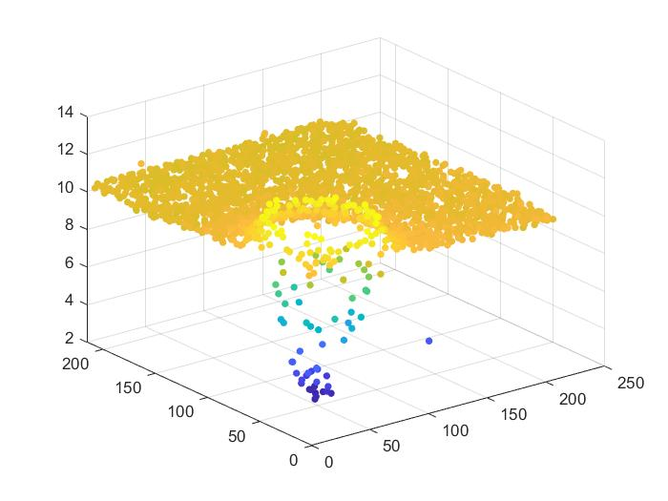
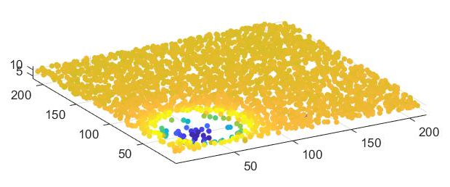
Fluorescent Confocal data after particle-locating MATLAB Script
Axes units in microns
(With Normalized axes)

Slide 9
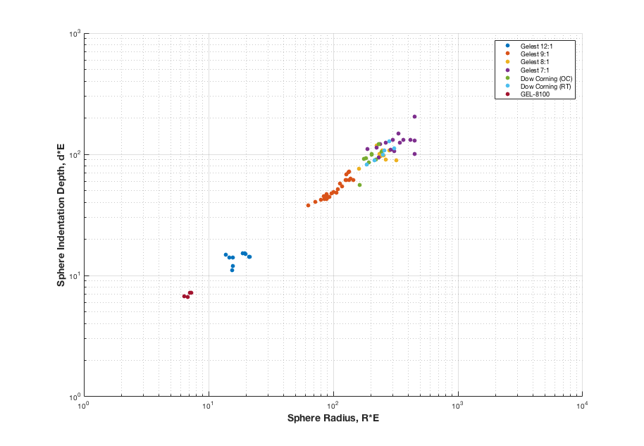
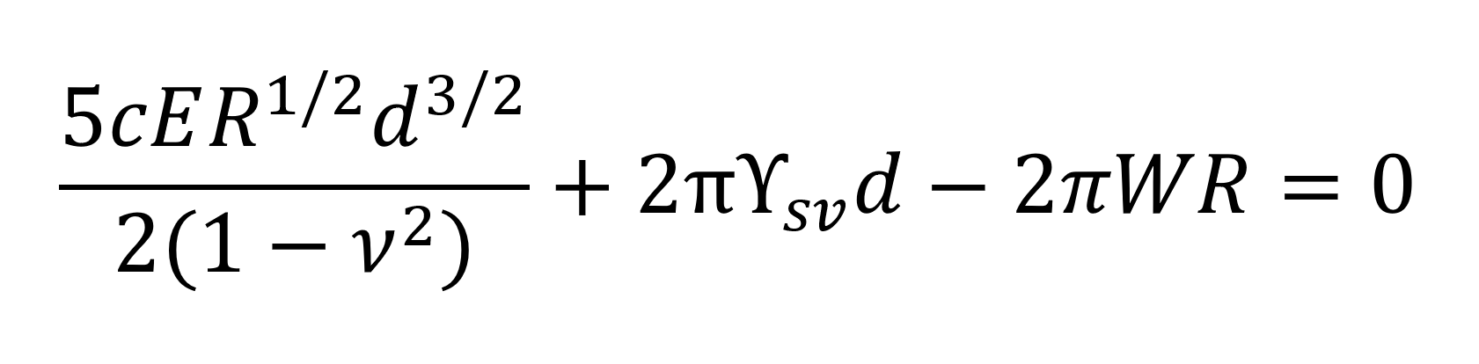

I helped!

Slide 10
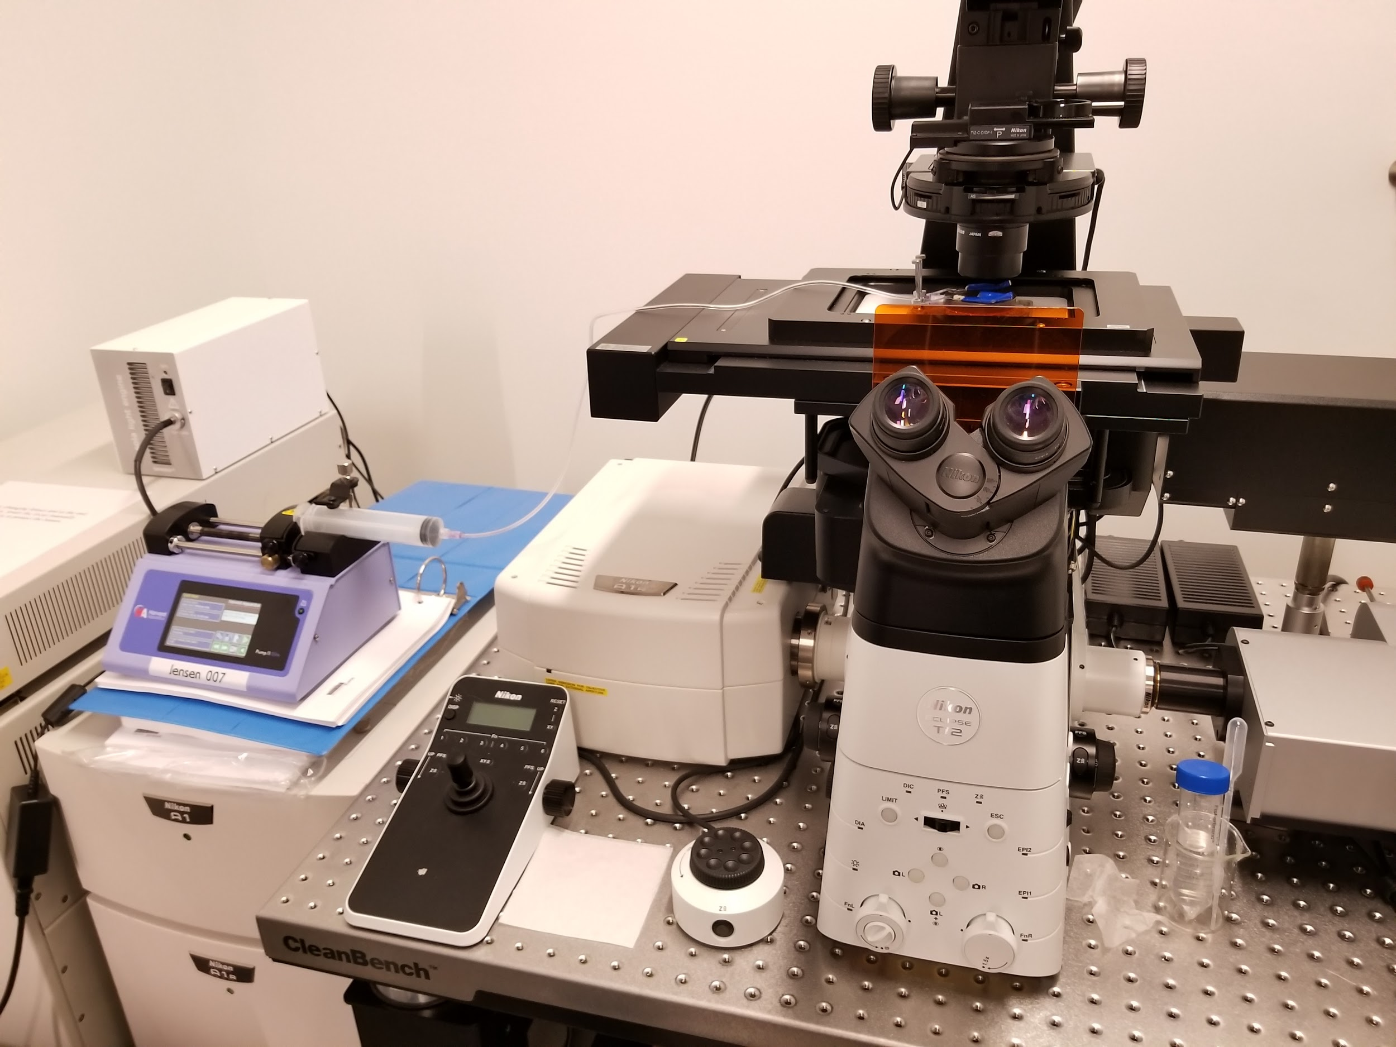

Slide 11
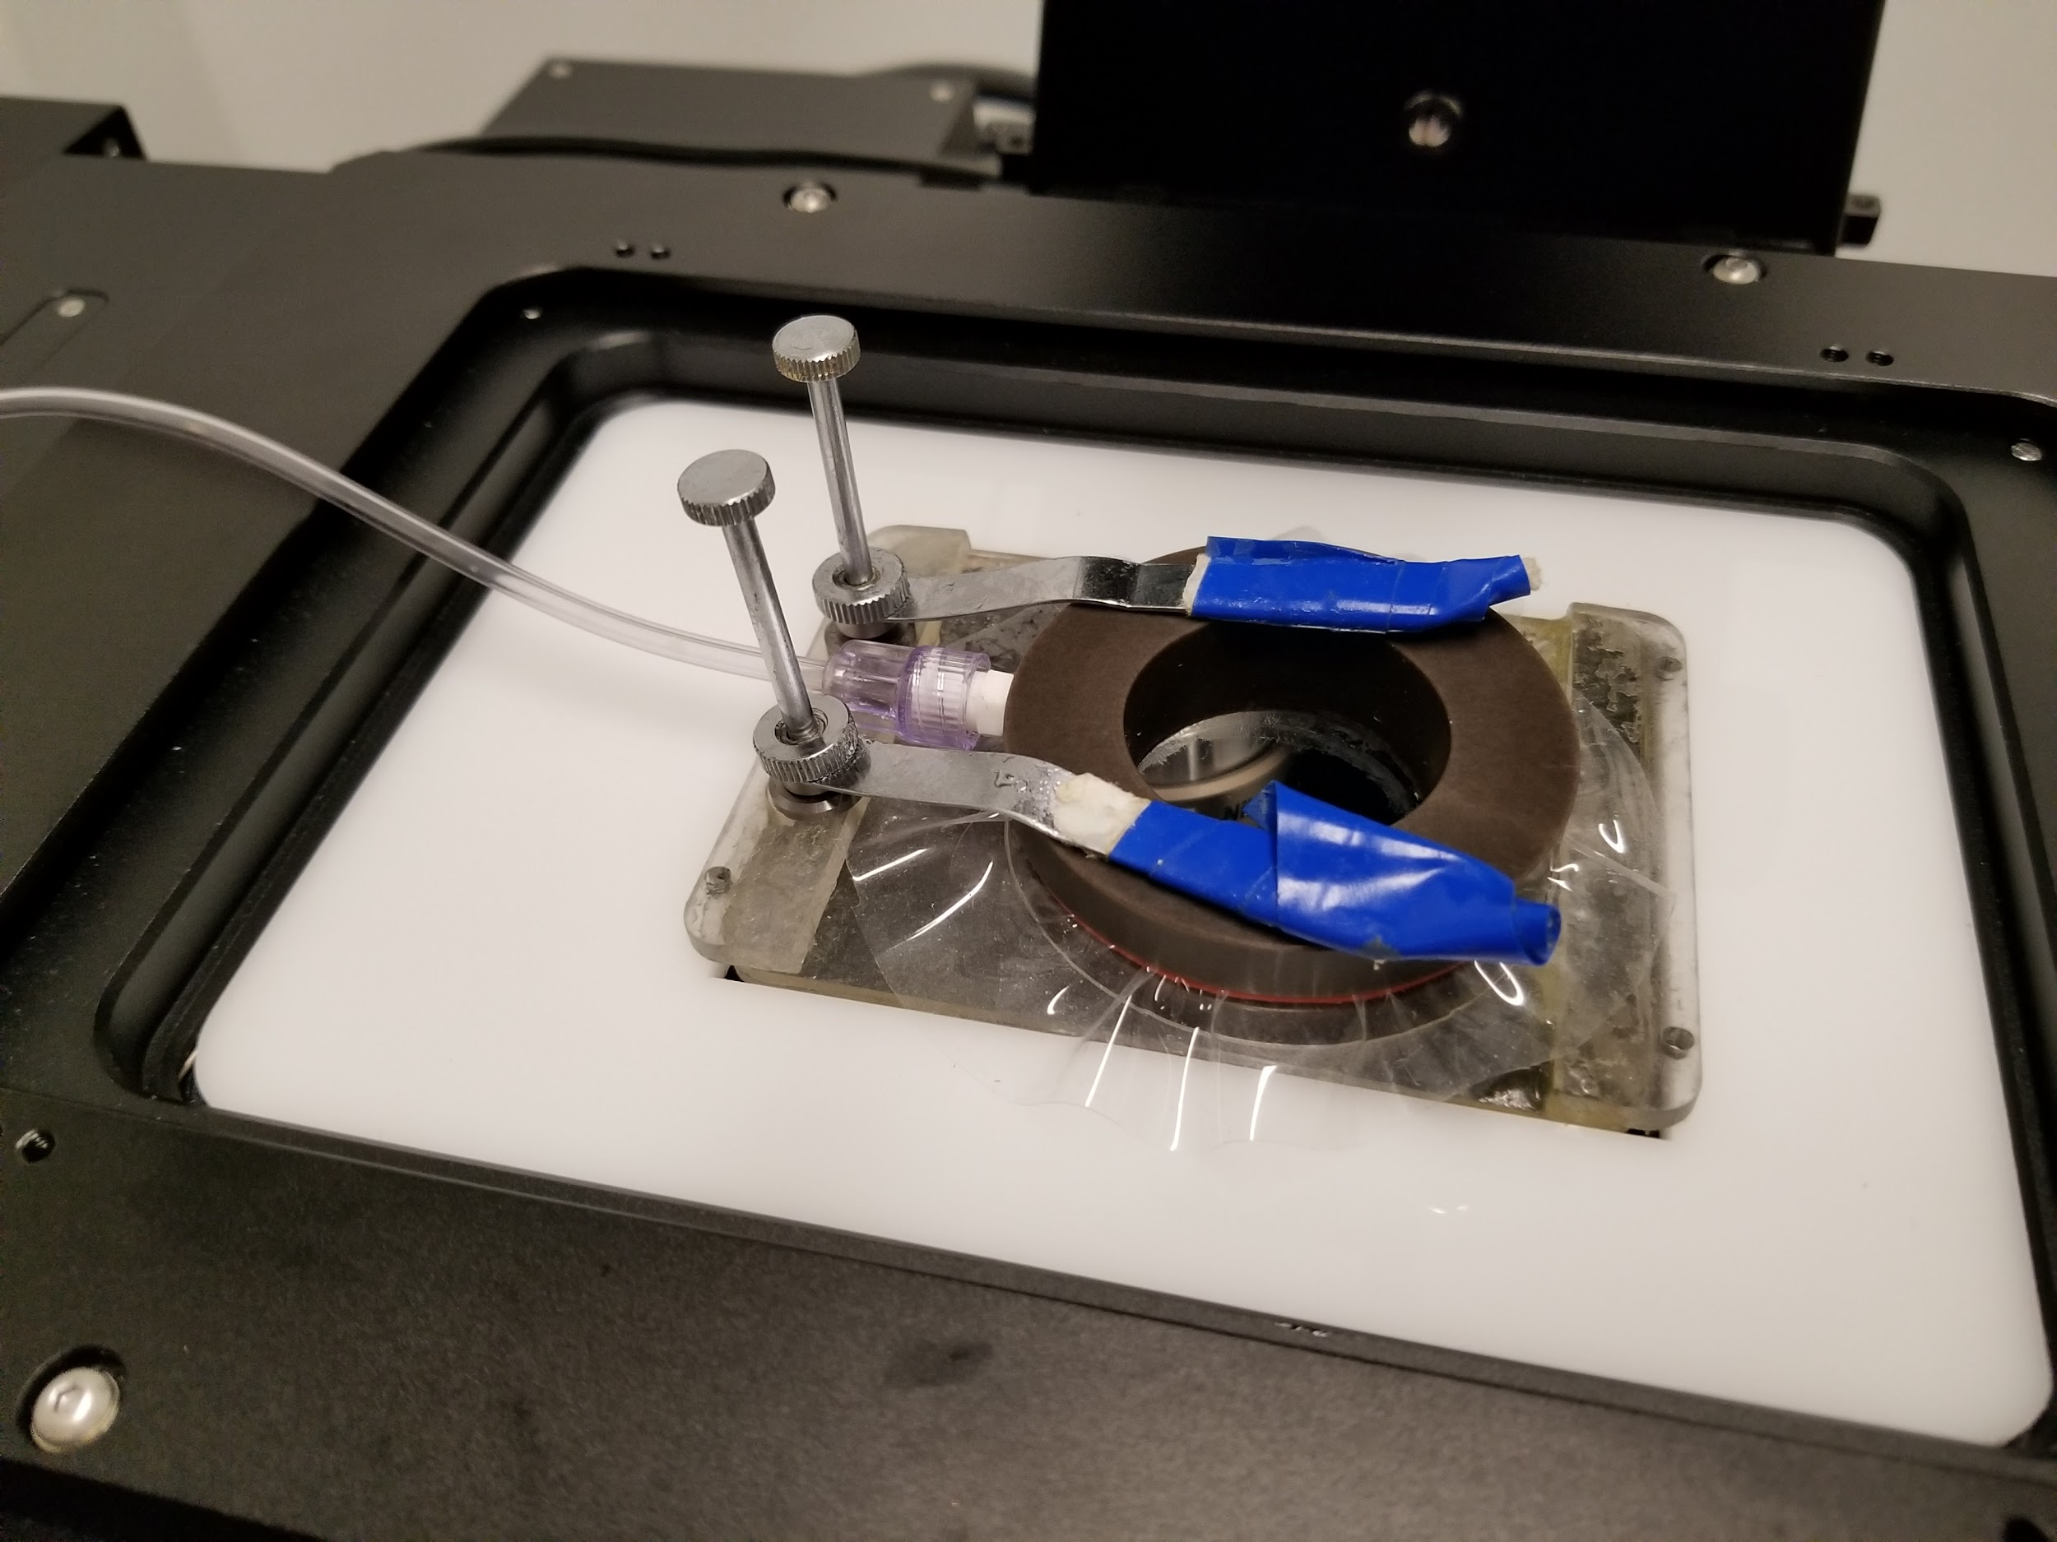

Slide 12
Question Two
2
Why do soft gels liquid phase-separate under adhesive contacts?
What determines the volume of fluid separation?
Notes:
Our second research question is on the liquid phase separation of soft silicone gels under adhesive contact. This is another recent discovery in soft materials mechanics, and so it has not yet been fully explained why this phenomenon occurs. My goals is to understand which variables determine the volume of phase separation through a series of experiments.

Slide 13
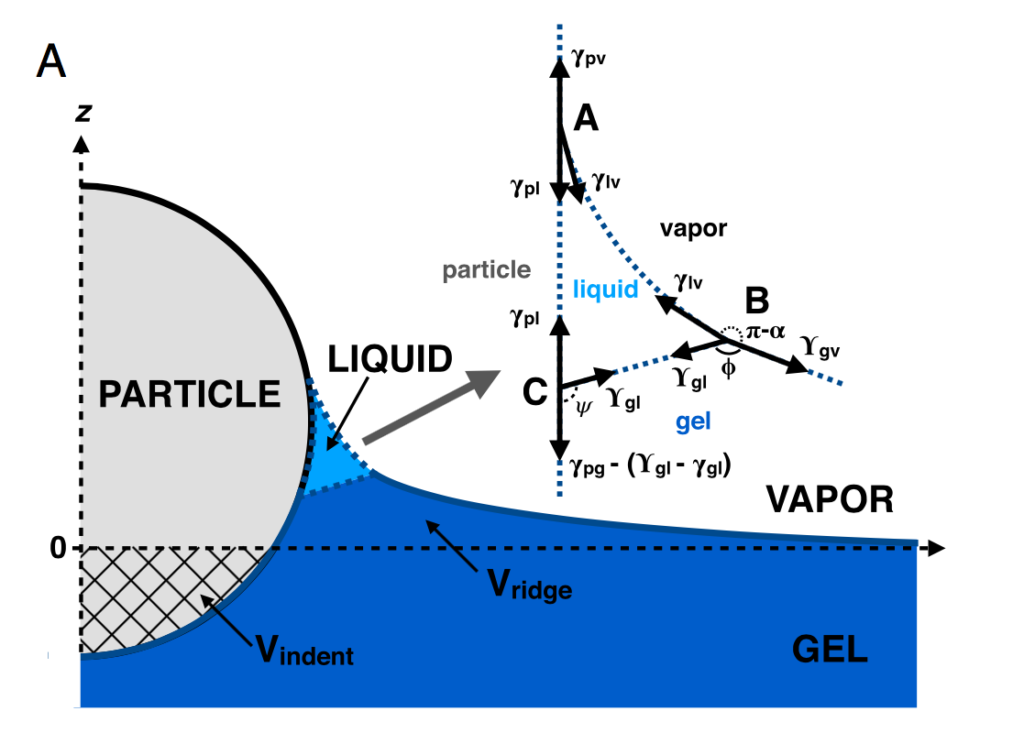
Recap: Adhesion-Induced Fluid Separation in Soft Silicone Gels
Jensen et al. (2015) Wetting and phase separation in soft adhesion. PNAS 112 (47) 14490-14494
Notes:
The set-up is identical to Jeremy’s experiments: we sprinkle silica microspheres on a flat, elastic gel substrate.
Now, the focus is on the sharp “cusp” located right next to the particle. If you look at this contact zone with a confocal microscope, what you get to see is the hat show the actual “solid” surface profile, one like this picture. There is this notable, awkward geometry that the gel surface forms and maintains--why? Well, this is the same question Professor Jensen and her colleagues asked back in 2015, and what they did was to compare this images with images from bright-field microscopy. They figured out that this “missing” piece is actually made up of liquid silicone. What is happening here is that some fraction of solvent phase silicone from inside the gel has phase-separated out to grab on to the sphere, creating this sharp contact line that a solid gel cannot possibly attain without a divergent elastic stress.
So, why care about fluid separation? First, silicone is used everywhere, from vacuum seals, hair products to soft robots, and what we’ve just found out is that whenever soft silicone is in contact with rigid bodies, there is some amount of liquid silicone complicating the contact mechanics. What was previously thought to be a three-phase contact is actually a four-phase contact: the particle, the gel, vapor (most likely air), and liquid silicone!

Slide 14
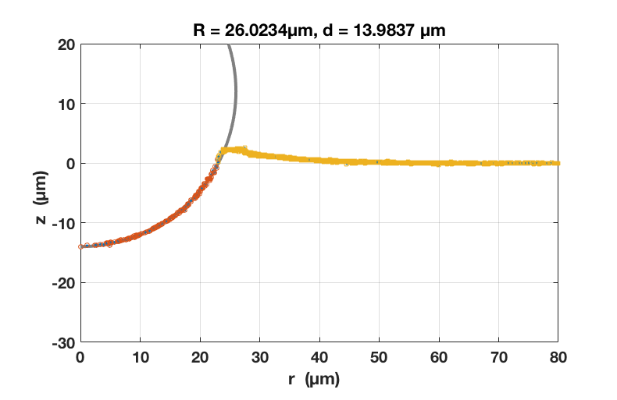
Displaced Fluid Volume Calculation via Integration
MATLAB Numerical Integration
Compare volumes under & above surface ( z=0 )
Calculate the “missing” volume:
(For PDMS, ~ 0.5 / incompressible )
Notes:
To dive further in, we first want to measure and quantify the fluid separation volume, and we do this through integration based on confocal profiles. As usual, we did this in MATLAB.
Vunder, the indentation volume, is the volume taken up by the sphere below the plane of undeformed silicone surface, indicated by the black dotted line.
Vover is the volume gel substrate that has been pushed up above the original surface. Since liquid PDMS silicone is effectively incompressible, we can calculate the “missing” fluid volume as the difference between these two quantities.

Slide 15
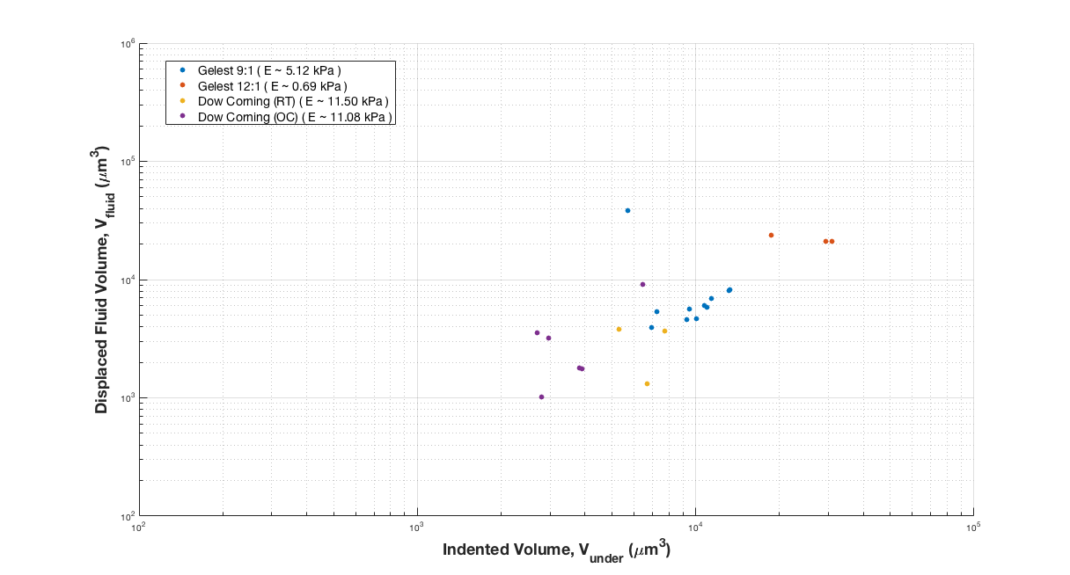
Fluid Volume vs. Indented Volume : “Softer” Silicone
4/3
Notes:
So oe obvious variable would affect the fluid volume is the the indentation volume. The more you indent, press in, the more fluid from phase separates from inside and comes out. Here are some data that we gathered from 4 different silicone substrates with varying stiffnesses (varying Young’s moduli). The names Gelest and Dow Corning refer to different manufacturers, so they have slightly different compositions. We see that all of our points fall on a linear pattern. This shows that the volume of the phase-separated region scales as a 4/3 - power law with respect to the indentation volume

Slide 16
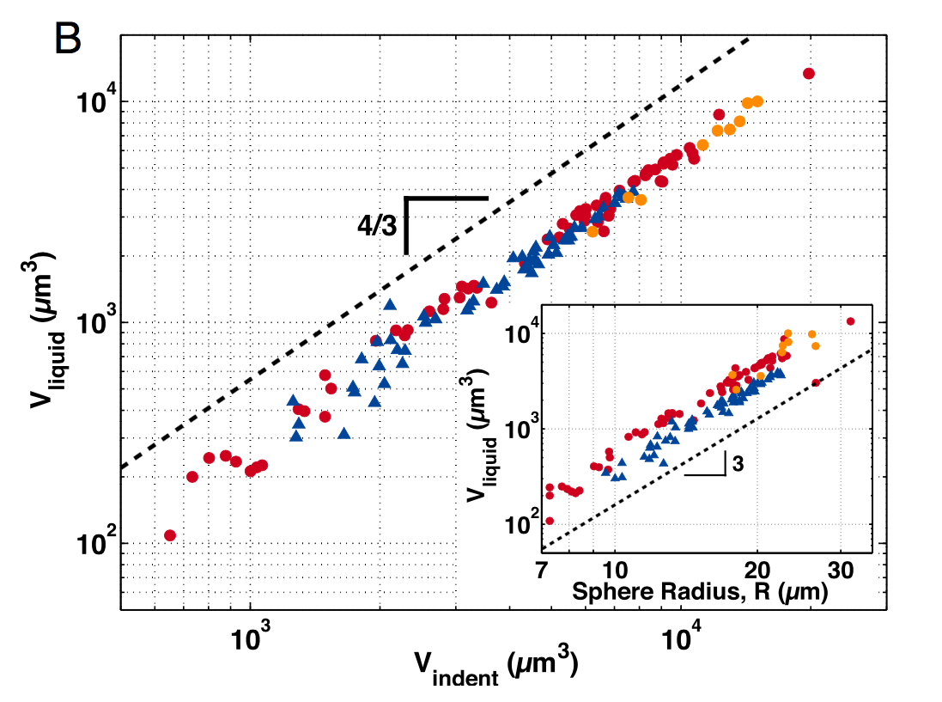
Fluid Volume vs. Indented Volume : Previous Literature
Substrate: Gelest 9:1 (E ~ 5.6 kPa)
: plain silica
: fluorocarbon-functionalized silica
: plain silica under glycerol
Jensen et al. (2015) Wetting and phase separation in soft adhesion. PNAS 112 (47) 14490-14494
Notes:
While there is no satisfactory theoretical model for this question, the 2015 publication reported the same 4/3 power law. While our data from before showed that this power law holds for silicone with different stiffnesses and different compositions, this data shows that the surface properties of the microspheres do not matter as well.

Slide 17
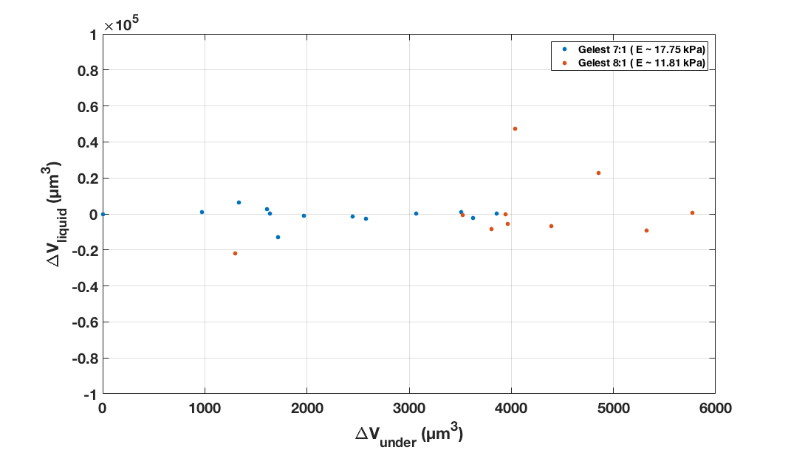
Fluid Volume vs. Indented Volume : “Stiffer” Silicone
Notes:
However, interesting is that for stiffer silicone, it seems like we observe no liquid phase separation. It may be that there is a cutoff in gel stiffness , or it might simply be that we have hit the noise floor. To figure out which is true, I plan to use a micromanipulator to further indent the surface of these stiffer silicone and see if it causes fluid phase separation. In the near future, I also look forward to extending my project to soft gels other than silicone, such as hydrogels.

Slide 18
Science?

Slide 19
Sources
Presentation template by SlidesCarnival

